Slide 1

Lab 9:Period of a Pendulum
St. Petersburg College

Slide 2
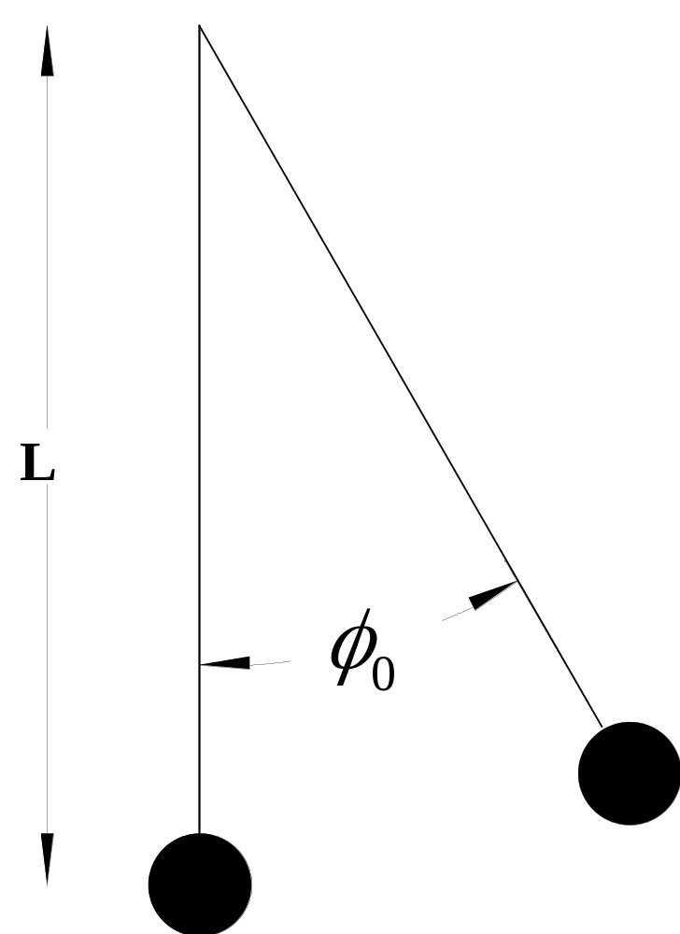
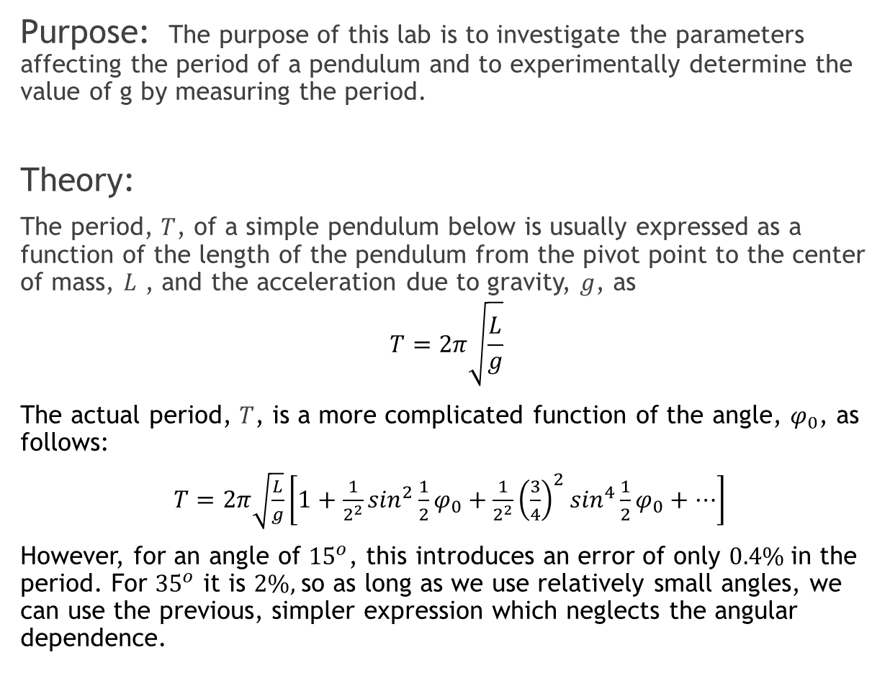
Introduction
Purpose: The purpose of this lab is to investigate the parameters affecting the period of a pendulum and to experimentally determine the value of g by measuring the period.
Theory:
The period, $T$, of a simple pendulum below is usually expressed as a function of the length of the pendulum from the pivot point to the center of mass, $L$ , and the acceleration due to gravity, $g$, as
$$T=2π\sqrt{\frac{L}{g}}$$
The actual period, $T$, is a more complicated function of the angle, $φ_{0}$, as follows:
$T=2π\sqrt{\frac{L}{g}}\left[1+\frac{1}{2^{2}}\sin^{2}{\frac{1}{2}φ_{0}}+\frac{1}{2^{2}}{\left(\frac{3}{4}\right)}^{2}\sin^{4}{\frac{1}{2}φ_{0}+⋯}\right]$
However, for an angle of ${15}^{o}$, this introduces an error of only $0.4\%$in the period. For ${35}^{o}$ it is $2\%,$so as long as we use relatively small angles, we can use the previous, simpler expression which neglects the angular dependence.

Slide 3
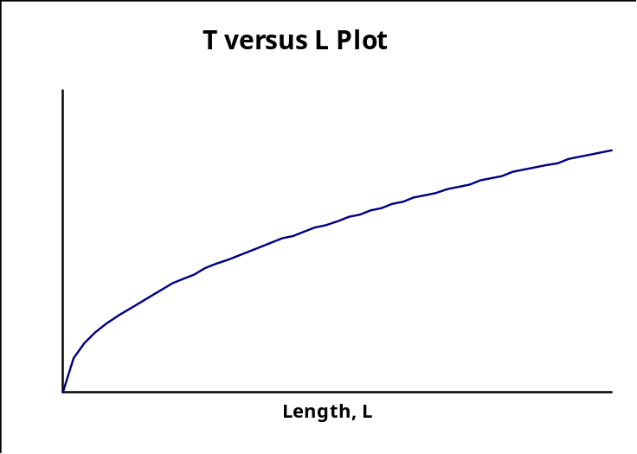
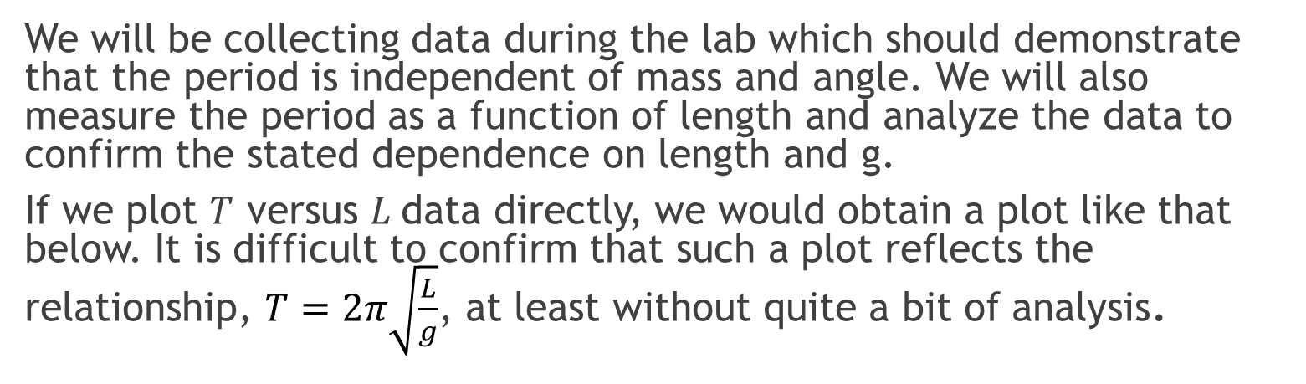
Introduction, Cont
We will be collecting data during the lab which should demonstrate that the period is independent of mass and angle. We will also measure the period as a function of length and analyze the data to confirm the stated dependence on length and g.
If we plot $T$ versus $L$data directly, we would obtain a plot like that below. It is difficult to confirm that such a plot reflects the relationship, $T=2π\sqrt{\frac{L}{g}}$, at least without quite a bit of analysis.

Slide 4
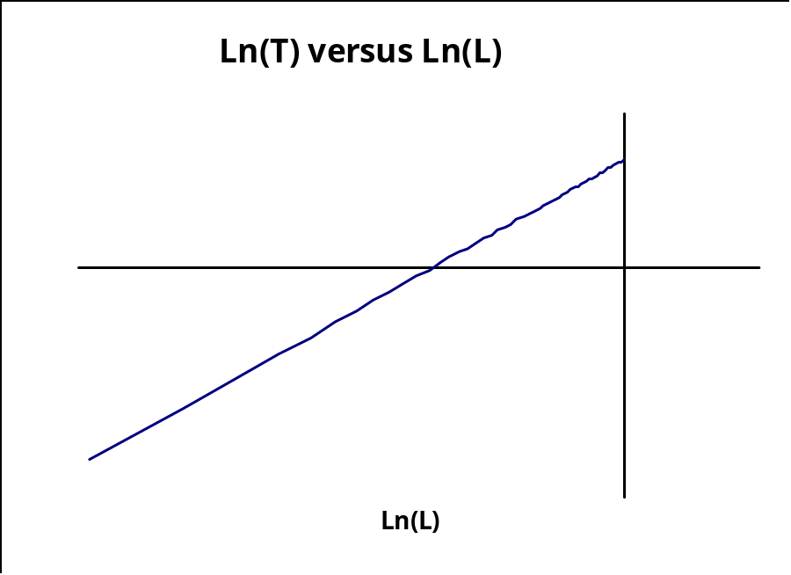
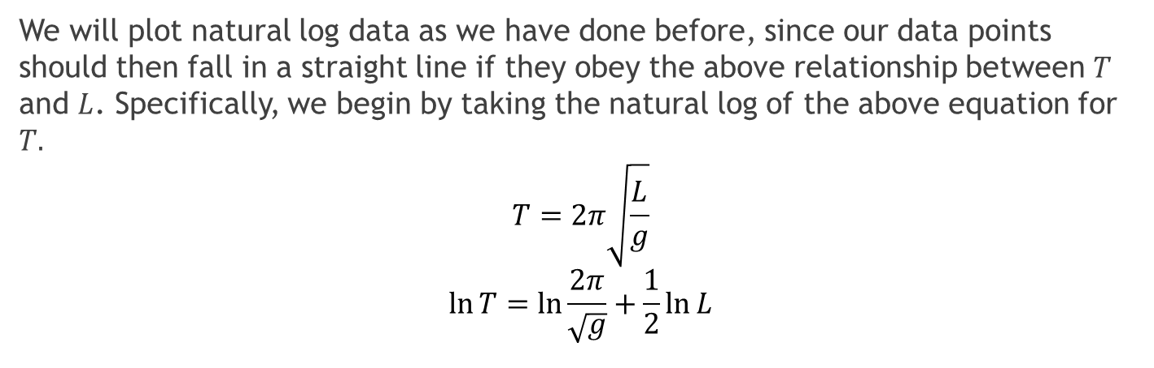
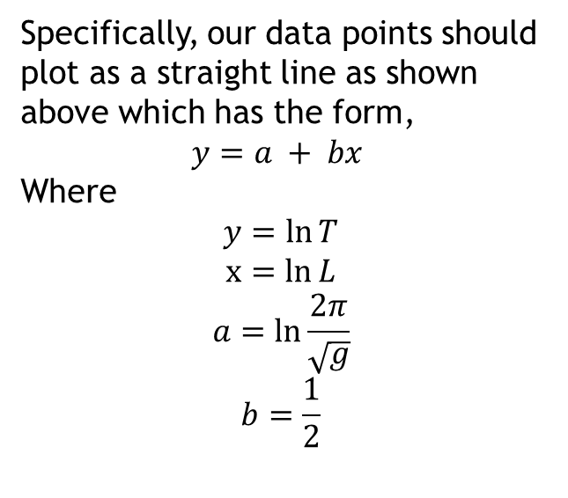
Introduction, Cont.
We will plot natural log data as we have done before, since our data points should then fall in a straight line if they obey the above relationship between $T$ and $L$. Specifically, we begin by taking the natural log of the above equation for $T.$
$$T=2π\sqrt{\frac{L}{g}}$$
$$\ln{T}=\ln{\frac{2π}{\sqrt{g}}}+\frac{1}{2}\ln{L}$$
Specifically, our data points should plot as a straight line as shown above which has the form,
$$y=a + bx$$
Where
$$y=\ln{T}$$
$$x=ln{L}$$
$$a=\ln{\frac{2π}{\sqrt{g}}}$$
$$b=\frac{1}{2}$$

Slide 5
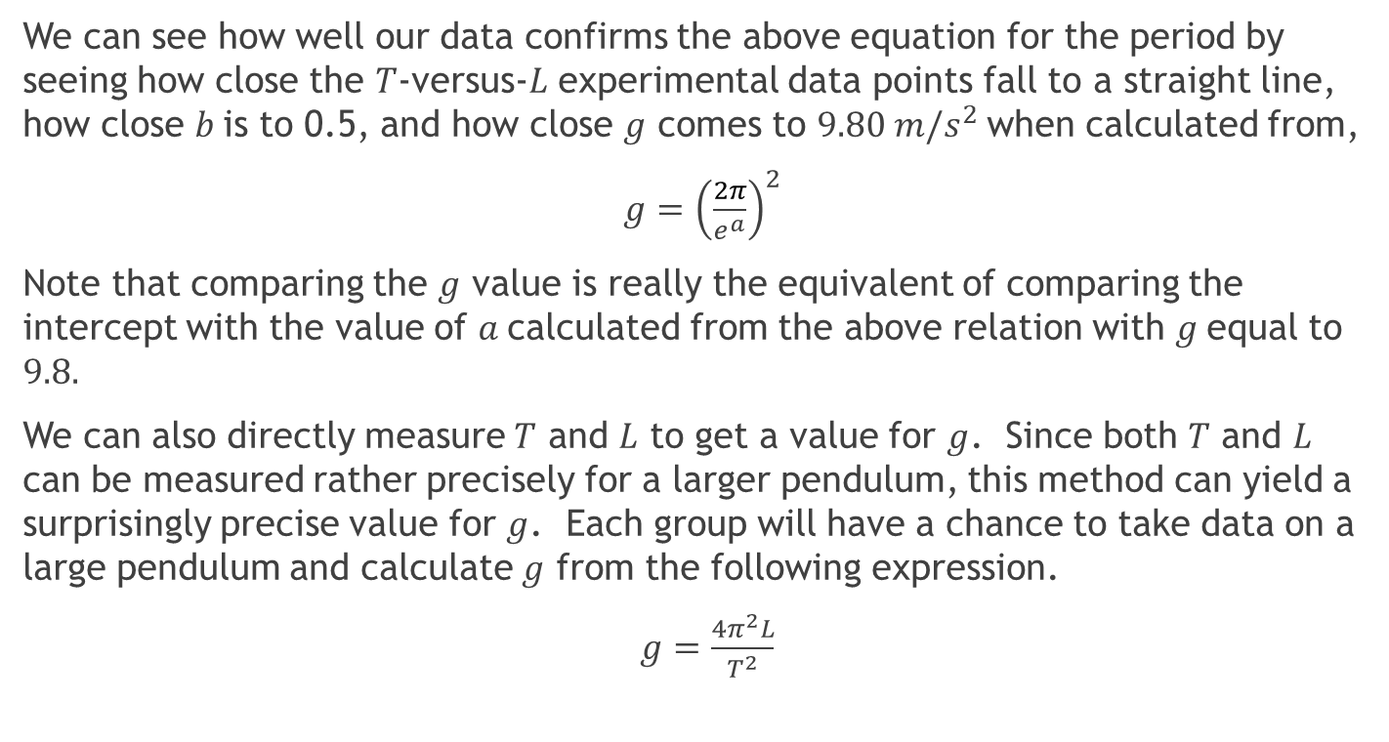
Introduction, Cont
We can see how well our data confirms the above equation for the period by seeing how close the $T$-versus-$L$ experimental data points fall to a straight line, how close $b$is to 0.5, and how close $g$ comes to $9.80 m/s^{2}$when calculated from,
$g={\left(\frac{2π}{e^{a}}\right)}^{2}$
Note that comparing the $g$ value is really the equivalent of comparing the intercept with the value of $a$calculated from the above relation with $g$equal to $9.8.$
We can also directly measure $T$ and $L$ to get a value for $g$. Since both $T$ and $L$ can be measured rather precisely for a larger pendulum, this method can yield a surprisingly precise value for $g$. Each group will have a chance to take data on a large pendulum and calculate $g$ from the following expression.
$g=\frac{4π^{2}L}{T^{2}}$

Slide 6
Apparatus
Meter Stick | Stopwatch
Lab Pro | string
Spherical Bob | Large protractor
Pendulum Clamp

Slide 7

Procedure 1., Changing Mass
1. Set up your pendulum as shown by your instructor. The longer the pendulum the better for this part of the lab, subject of course to practical limitations. You will be changing the pendulum length throughout the experiment, so feed the string through a hole in the apparatus and tie it off in a way that will be easy to untie and change the length. Step 1:Verify that the period is independent of mass. You will do this by measuring the period for two different masses while keeping the length constant. Keeping the length constant can be tricky because you must judge the center of mass for the bob. Use a stopwatch to time. Start the pendulum swinging and when satisfied that it is in a good position, time the bob for about 10 cycles and record your data below. It is not necessary to start timing when you release the bob. Start timing when it passes a convenient reference point, e.g., the pole in the table that facilitates counting cycles. One cycle is the time it takes for the bob to return to the same point and be moving in the same direction: either at the bottom or at the starting point.

Slide 8

Procedure 2., Changing Angles
2. Using your last setup and procedure in step 1, hold a protractor at the pivot point to roughly set the arc of the pendulum to the values below using a protractor, time about 10 cycles, and calculate the period. Again, don't spend too much time on this step. While you know there is some dependence for large angles, you should see little or no detectable change here based on the numbers presented above. Nevertheless, for the remainder of the lab you should try to keep the arc small.

Slide 9
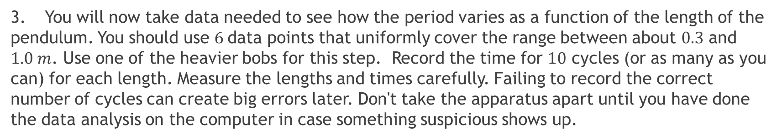
Procedure 3., Changing length
3. You will now take data needed to see how the period varies as a function of the length of the pendulum. You should use $6$data points that uniformly cover the range between about $0.3$ and $1.0 m$. Use one of the heavier bobs for this step. Record the time for $10$ cycles (or as many as you can) for each length. Measure the lengths and times carefully. Failing to record the correct number of cycles can create big errors later. Don't take the apparatus apart until you have done the data analysis on the computer in case something suspicious shows up.
Length, L ( ) | Cycles, N | Time, t ( )
Take your data to a lab computer and create a spreadsheet like the attached “Spreadsheet to Examine Period as a Function of Pendulum Length” to analyze your data. Your data plots should quickly help you identify any major errors, e.g., the wrong number of cycles, which you can correct before saving. Each Team should save a copy of the results to be submitted into the DropBox on MyCourses, with your lab report on the due date. Study all the class results and discuss within your group what they mean.

Slide 10
Procedure 4., Class Pendulum
4. Sometime during the lab period, go to the large pendulum. Carefully measure the pendulum length to the nearest mm and record the result in meters. Measure the length to the center of the pendulum bob. Use the photogate timer to obtain the period for this pendulum. Record the class data below for use in calculating a value for g.
Group | Length ( ) | Period T ( )

Slide 11
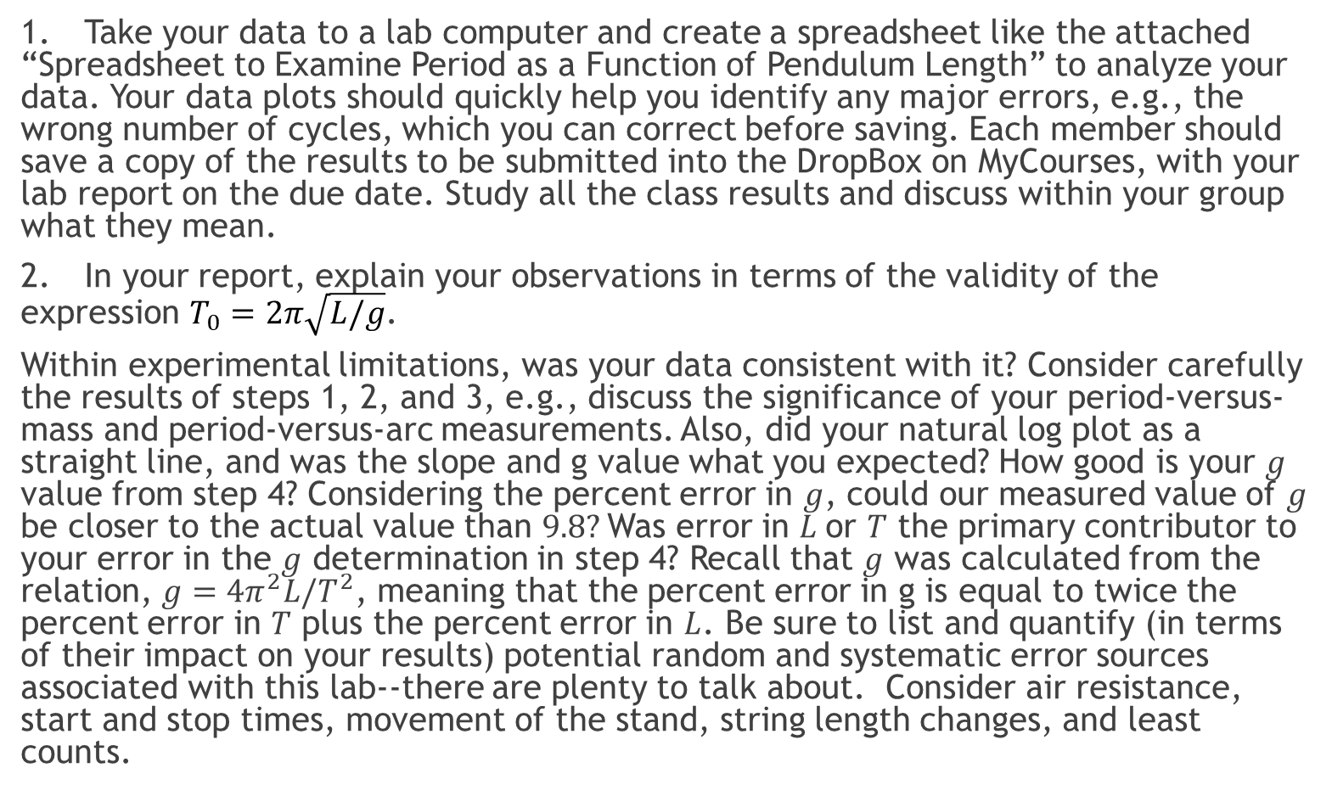
Summary and Analysis
1. Take your data to a lab computer and create a spreadsheet like the attached “Spreadsheet to Examine Period as a Function of Pendulum Length” to analyze your data. Your data plots should quickly help you identify any major errors, e.g., the wrong number of cycles, which you can correct before saving. Each member should save a copy of the results to be submitted into the DropBox on MyCourses, with your lab report on the due date. Study all the class results and discuss within your group what they mean.
2. In your report, explain your observations in terms of the validity of the expression $T_{0}=2π\sqrt{L/g}$.
Within experimental limitations, was your data consistent with it? Consider carefully the results of steps 1, 2, and 3, e.g., discuss the significance of your period-versus-mass and period-versus-arc measurements. Also, did your natural log plot as a straight line, and was the slope and g value what you expected? How good is your $g$ value from step 4? Considering the percent error in $g$, could our measured value of $g$ be closer to the actual value than $9.8?$Was error in $L$or $T$ the primary contributor to your error in the $g$ determination in step 4? Recall that $g$ was calculated from the relation, $g=4π^{2}L/T^{2}$, meaning that the percent error in g is equal to twice the percent error in $T$ plus the percent error in $L$. Be sure to list and quantify (in terms of their impact on your results) potential random and systematic error sources associated with this lab--there are plenty to talk about. Consider air resistance, start and stop times, movement of the stand, string length changes, and least counts.

Slide 12
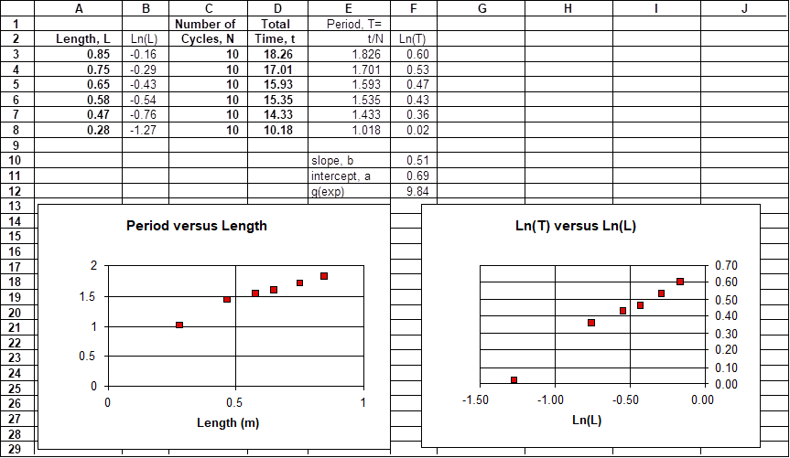
Spreadsheet
Spreadsheet to Examine Period as a Function of Pendulum Length: (Include units next to title of columns; graph axes; mean values; slope, intercept etc.)

Slide 13
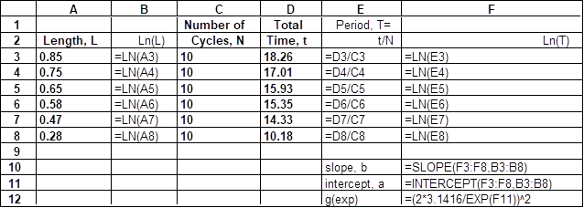
Spreadsheet Formulas
Spreadsheet Formulas to Examine Period as a Function of Pendulum Length

Slide 14
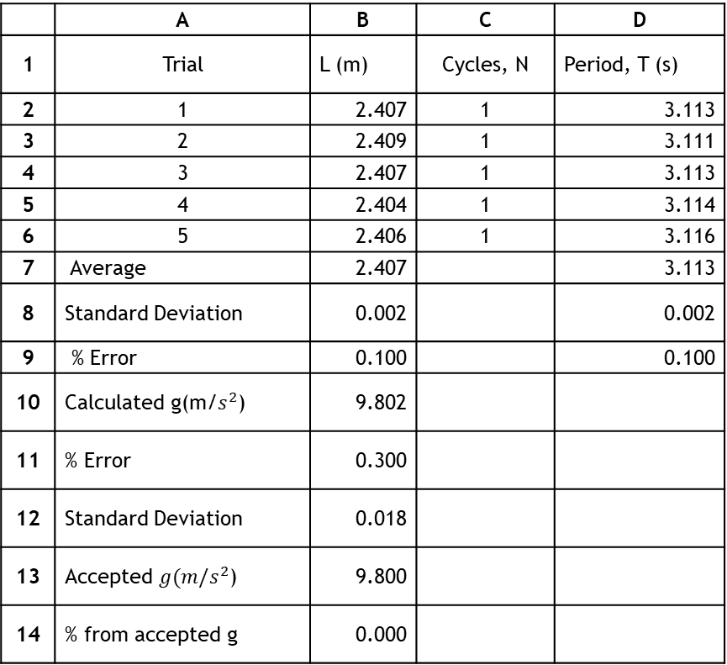
Spreadsheet – Calculation of ‘g’
g Calculation Spreadsheet
 | A | B | C | D
1 | Trial | L (m) | Cycles, N | Period, T (s)
2 | 1 | 2.407 | 1 | 3.113
3 | 2 | 2.409 | 1 | 3.111
4 | 3 | 2.407 | 1 | 3.113
5 | 4 | 2.404 | 1 | 3.114
6 | 5 | 2.406 | 1 | 3.116
7 | Average | 2.407 |  | 3.113
8 | Standard Deviation | 0.002 |  | 0.002
9 | % Error | 0.100 |  | 0.100
10 | Calculated g(m/$s^{2}$) | 9.802
11 | % Error | 0.300
12 | Standard Deviation | 0.018
13 | Accepted $g(m/s^{2}$) | 9.800
14 | % from accepted g | 0.000

Slide 15
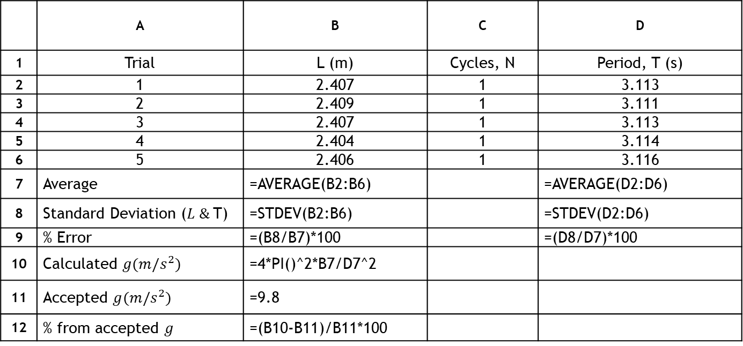
Spreadsheet -- Calculation of ‘g’ (cont.)
g Calculation Spreadsheet Formulas
 | A | B | C | D
1 | Trial | L (m) | Cycles, N | Period, T (s)
2 | 1 | 2.407 | 1 | 3.113
3 | 2 | 2.409 | 1 | 3.111
4 | 3 | 2.407 | 1 | 3.113
5 | 4 | 2.404 | 1 | 3.114
6 | 5 | 2.406 | 1 | 3.116
7 | Average | =AVERAGE(B2:B6) |  | =AVERAGE(D2:D6)
8 | Standard Deviation ($L \&$T) | =STDEV(B2:B6) |  | =STDEV(D2:D6)
9 | % Error | =(B8/B7)*100 |  | =(D8/D7)*100
10 | Calculated $g(m/s^{2})$ | =4*PI()^2*B7/D7^2
11 | Accepted $g(m/s^{2})$ | =9.8
12 | % from accepted $g$ | =(B10-B11)/B11*100

